Slide 1
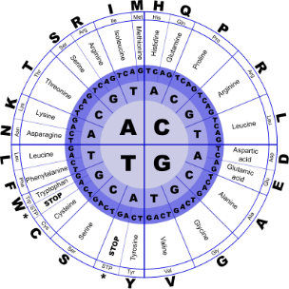
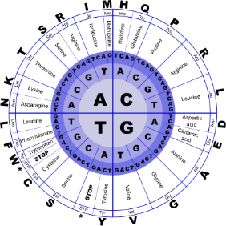


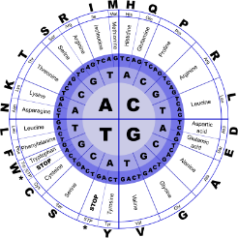
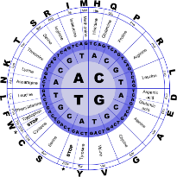
Fundamentals of Programming II
Recursion

Slide 2
Recursion
A recursive function is a function that calls itself.
Recursive functions can be useful in solving problems that can be broken down into smaller or simpler subproblems of the same type. A base case should eventually be reached, at which time the breaking down (recursion) will stop.

Slide 3
Recursive Functions
Consider a function for solving the count-down problem from some number num down to 0:
The base case is when num is already 0: the problem is solved and we “blast off!”
If num is greater than 0, we count off num and then recursively count down from num-1

Slide 4
Recursive Functions
A recursive function for counting down to 0:
void countDown(int num)
{
if (num == 0)
cout << "Blastoff!";
else
{
cout << num << ". . .";
countDown(num-1); // recursive
} // call
}
If a program contains a line like countDown(2);
countDown(2) generates the output 2..., then it calls countDown(1)
countDown(1) generates the output 1..., then it calls countDown(0)
countDown(0) generates the output Blastoff!, then returns to countDown(1)
countDown(1) returns to countDown(2)
countDown(2)returns to the calling function

Slide 5
What Happens When Called?
first call to
countDown
num is 2
OUTPUT:
2...
countDown(1);
second call to
countDown
num is 1
1...
countDown(0);
third call to
countDown
num is 0
Blastoff!
// no
// recursive
// call

Slide 6
Stopping the Recursion
A recursive function should include a test for the base cases
In the sample program, the test is:
if (num == 0)

Slide 7
Stopping the Recursion
void countDown(int num)
{
if (num == 0) // test
cout << "Blastoff!";
else
{
cout << num << "...\n";
countDown(num-1); // recursive
} // call
}

Slide 8
Stopping the Recursion
With each recursive call, the parameter controlling the recursion should move closer to the base case
Eventually, the parameter reaches the base case and the chain of recursive calls terminates

Slide 9
Stopping the Recursion
void countDown(int num)
{
if (num == 0) // base case
cout << "Blastoff!";
else
{ cout << num << "...\n";
countDown(num-1);
}
}
Value passed to recursive call is closer to base case of num = 0.

Slide 10
What Happens When Called?
Each time a recursive function is called, a new copy of the function runs, with new instances of parameters and local variables being created
As each copy finishes executing, it returns to the copy of the function that called it
When the initial copy finishes executing, it returns to the part of the program that made the initial call to the function

Slide 11
The Recursive Factorial Function
The factorial of a nonnegative integer n is the product of all positive integers less or equal to n
The factorial of n is denoted by n!
The factorial of 0 is 1
0 ! = 1
n ! = n x (n-1) x … x 2 x 1 if n > 0

Slide 12
The Recursive Factorial Function
Factorial of n can be expressed in terms of the factorial of n-1
0 ! = 1
n ! = n x (n-1) !
Recursive function
int factorial(int n)
{
if (n == 0)
return 1;
else
return n *factorial(n-1);
}

Slide 13
The Recursive Factorial Function
If n==0, do nothing (base case)
If n>0, then
Move the topmost n-1 disks from peg1 to peg2
Move the n^{th} disk from peg1 to peg3
Move the n-1 disks from peg2 to peg3
end if

Slide 14
Recursion vs. Iteration
Benefits (+), disadvantages(-) for recursion:
Natural formulation of solution to certain problems
Results in shorter, simpler functions
May not execute very efficiently
Benefits (+), disadvantages(-) for iteration:
Executes more efficiently than recursion
May not be as natural a method of solution as recursion for some problems

Slide 15
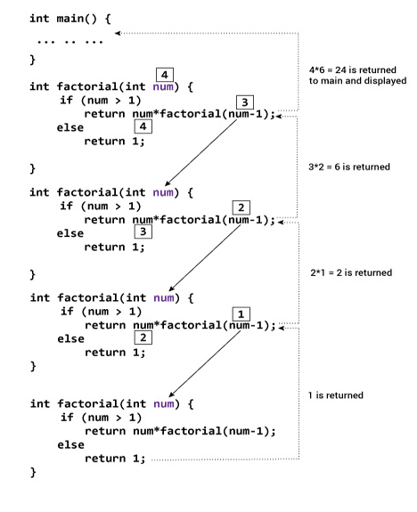
Recursion vs. Iteration

